Slide 1
What is express:
This is a server side web framework for node
Uses:
To Develop Server Side Rest API For Mobile, Desktop, Web Applications and IOT devices
Using template engine with express you can develop complete web site or web application too.
You can use react, vue or angular with express to develop complete web site or web application

Slide 2
What will be our learning strategy
Express Rest API Development
Working with template engine and express together
Working with react and express together
Deploy & Testing With Real server

Slide 3
Tools:
Node
WebStrom
Postman
Knowledge Required:
Node and JavaScript

Slide 4
My First
Express Application

Slide 5



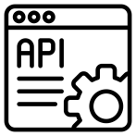


What is Rest API
( Representational State Transfer)
Server Script /
Server Side
Rest API
Database
Client Side

